Slide 1


Business Transition Planning
(or the lack there of)
Disruptive events and the lack of planning
Joe Bione and James Linton
Whitehall Group LLC
August 17, 2022

Slide 2
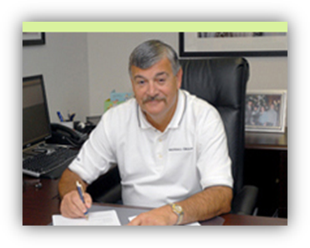
Joseph Bione is President and founder of the Whitehall Group with over 35+ years of experience in Transition Planning, manufacturing and restructuring. Mr. Bione’s expertise includes the areas of operations, finance, reengineering, enterprise lean, continuous improvement and supply chain management. The Whitehall Group provides services to companies in transition or trouble.
In industry, Mr. Bione has served as Interim CEO/President for many clients during transition and return to profitability, including CMI Holdings, Venture Industries, Talon Automotive Group, Como Plastics, Detroit Plastic Molding and Kuhlman Automotive Group. He is currently serving as Interim President/CEO for American Special Vehicle Cars, (ASC) where he has won the 2016 Manufacturing Leadership Award (ML100) for Visionary Leadership. He was recently engaged as EVP of Operations at Constar, Inc. a $500MM manufacturing company, working with a team on restructuring the company, where he won the 2012 Manufacturing Leadership 100 (ML 100) Award for Turnarounds. Mr. Bione is on the Governors’ list of potential Emergency Managers and Whitehall has been approved by the State of Michigan as an approved “Turnaround and Restructuring” resource. (Contract # 271B4300019)
Mr. Bione started his manufacturing career in “Erie, PA” at the Jacob Haller Company, AMSCO and then Johnson Controls, where he served as VP & General Manager for both the Automotive Group and Beverage Bottle Division and at the American Sterilizer Company, as Director of Operations for the Medical Products Division. Mr. Bione was also a Partner at Deloitte Consulting in the Automotive, Supply Chain and Restructuring Practices with Global Account Responsibility for DaimlerChrysler and co-leadership of the Global Automotive Practice.
Mr. Bione is a frequent speaker at industry events, including the MICPA Management and Information Business Show, the Automotive News APD Motor Vehicle Metal Resins Conference and the OESA “Best Practices” Regional Meetings. He also contributed two guest columns in both the TMA newsletter and at the OESA Annual Outlook Conference. He participated in Powerplex as a guest speaker, the Automotive Supplier Finance Summit, and Eastern Michigan’s College of Business’ Ethos Week. Besides speaking, Mr. Bione has authored a series of four (4) articles in addressing the “Business Transition Issues” that companies are facing today featured in Business Management Magazine.
Mr. Bione was an Advisory Board Member of Gannon University’s Business & Engineering Programs, University of Detroit Mercy’s Turnaround Management M.B.A. program, Eastern Michigan University’s Supply Chain Management program. He is currently a member of the Erie Chamber of Commerce and sits on an advisory board at the Children’s Hospital of Michigan Foundation. Mr. Bione earned his B.S. in Business Management with a minor in Engineering, an M.B.A. in Organizational Behavior, and the “Distinguished Alumni Award” from Gannon University in Erie, PA. His certifications include the CPM (Purchasing), CPIM (Production Control & Inventory), and is a longtime member of the Turnaround Management Association. (TMA)

Slide 3
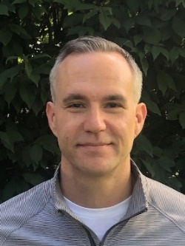
Experience in manufacturing. logistics and restructuring - areas of operations, finance, lean management, quality control, continuous improvement, supply chain management, leadership training and executive coaching.
Primarily served as both COO or CFO for clients in transition helping companies return to profitability.
Started career at DaimlerChrysler as a graduate of the Chrysler Institute of Engineering Management Trainee Program.
Moved on to various consulting engagements, eventually running one of the largest third-party logistics providers (3PL) and Foreign Trade Zone (FTZ) operators in Metro Detroit –
Implemented several key performance indicators (KPI’s) across the business units and rolled up the financials to evaluate department contribution margins.
Led a full restructuring of the management team and eventually led the company to profitability quickly after the 2008-2009 financial crisis.
Received his B.S. in Industrial Engineering from Wayne State University where he also played Tartar baseball. He also received his M.S. in Engineering Management at the University of Michigan (Dearborn) and an MBA in Finance at the University of Detroit Mercy.
Certified analyst and an active member in the Turnaround Management Association (TMA).
Certified Executive and Leadership Coach.
Love’s spending time in nature while hiking and running the local trails or kayaking down the Huron River.
Serves as a BenjaMen of Huron Valley that strives to improving community with a local impact.

Slide 4


Management firm providing services to privately held middle market
companies in transition
  Serve clients through variety of channels
  Guided by needs and best interests of the client
  Serve primarily privately held, middle market companies
Utilize enterprise-wide methodologies for operational & financial improvement
  Rapidly improve bottom-line performance
  Right combination of experience, expertise, and client-side perspective
  Drive change and deliver value
Areas of expertise include:
  Financial reporting, analysis and controls
  Commercial marketing, selling and distribution
  Organization cultural changes, metrics and communication
  Operational evaluating, implementing and improving
  Strategic transition planning, analysis and execution
  Supply Chain procurement, logistics and distribution
Key differentiator is ability to actively assume operating roles and support
We are experienced business people who understand the issues
Notes:
4
4

Slide 5












Industry Leadership
We believe that in order to most effectively serve our clients, we must proactively contribute to setting the agenda and leading the dialog on how best to address industry challenges. Our past, recent and ongoing contributions include supporting the following organizations:
Frequent Speaker/Sponsor
Detroit Chapter – Silver Sponsor
Frequent Speaker/Sponsor
Turnaround Category
Visionary Leadership
Supply Chain Management Steering Committee
Visiting Lecturer
Advisory Board Member Business and Engineering
TMA/ MBA
Steering Committee
Affiliated Faculty
Chamber Member
Sponsor
Board Member/Sponsor
Speaker/Sponsor
Notes:
5
5

Slide 6


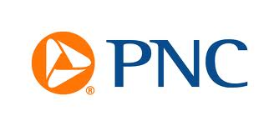





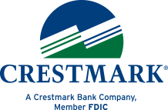


Whitehall has key business relationships with major Financial Institutions

Slide 7
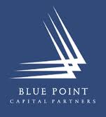




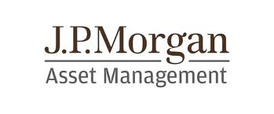


Whitehall has key relationships with major Private Equity firms

Slide 8
Most Privately Held Middle Market companies are owned by Baby Boomers
Majority of their wealth is tied up in the business
Their Lifestyle is driven by and in the business
Family members are also tied into the business either directly or indirectly
Transition planning discussions are discouraged to a large part (negative)
Most companies are not adapting to change in any manner (this is how we done things in the past that got us here)
The view from the top is inward not outward (No idea of what Big Guys are doing
Low in the supply chain (last to know of trends, changes and re alignments)
Have survived so far so must be doing something right
Have survived disruptions before and we made it
Always in a reaction mode vs planning mode
The D’s…Never going to Die, Divorce, Disease, Disagreements, Distress and Industry or Economic Disruptions,

Slide 9
Did you know…? (cont.)
Family Transition
30% of family-owned businesses reach to the second generation
12% of family-owned businesses reach to the third generation
3% of family-owned businesses reach to the fourth generation and beyond
One of ten business owners successfully pass their business successfully onto the next generation
Two thirds of business owners are not familiar with their exit options
78% of business owners have no formal transition plan/team
83% of business owners have no written exit plan
Without proper planning, only 20% of transactions close
With planning, 80% of transactions close
Do you have a plan and understand your options?
Notes:
9
9

Slide 10
Did you know……?
10,000 Baby Boomers turn 65 every day and they own > 50% of the privately held middle market businesses in the U.S.
80 – 90% of most business owners’ wealth is tied up in their business
50% of transitions are involuntary and happen due to events outside of an owner’s control, the D’s(Disability, Death, Divorce, Distress, Disagreement and Disruptive Events)
Only 12% of organizations have written and communicated transition plans
75% of business owners plan to transition in the next 10 years, about 50% in the next 5 years. This represents a transfer of 4,500,000 businesses and over $10 trillion of wealth
49% of business owners have not planned at all.
Business transitions are one time life events that people don’t anticipate, don’t understand, and don’t plan for, but should.
You must plan in order to protect your investment.
Notes:
10
10

Slide 11

Define a Disruptive Event:
WHEN A NEW PRODUCT OR SERVICE HELPS
create a new market
AND
significantly weakens, transforms, or
destroys an existing product, market category / industry
Are we headed for our next disruptive event and are you prepared ?
Notes:
11
11

Slide 12
Constant Change
What is 125 years old and still shows up every day for work, regardless of feeling negative or positive?
May 25th, 1896, Happy 125th Birthday to the Dow!!
The Dow Jones Industrial Average was founded by Charles Dow on May 26,1896 and represented the dollar average of 12 stocks from leading American industries.
Previously in 1884, Dow had composed an initial stock average called the Dow Jones Averages, which contained nine railroads and two industrial companies that appeared in the Customer's Afternoon Letter, a daily two-page financial news bulletin which was the precursor to The Wall Street Journal.
Since 1995 only 50% of Dow companies still exist.
Since 1955 only 5% of Dow companies still exist.
Notes:
12
12

Slide 13
Where are they now?
Of the original 12 stocks forming the Dow Jones Industrial Average compiled later in 1896, no longer railroad stocks, but purely industrial stocks, only General Electric is currently part of that index. The other 11 are:
American Cotton Oil Company, a predecessor company to Bestfoods, now part of Unilever.
American Sugar Company, became Domino Sugar in 1900, now Domino Foods, Inc.
American Tobacco Company, broken up in a 1911 antitrust action.
Chicago Gas Company, bought by Peoples Gas Light in 1897, now an operating subsidiary of Integrys Energy Group.
Distilling & Cattle Feeding Company, now Millennium Chemicals, formerly a division of Lyondell Basell, the latter of which is now in Chapter 11 bankruptcy.
Laclede Gas Company, still in operation as the Laclede Group, Inc., removed from the Dow Jones Industrial Average in 1899.
National Lead Company, now NL Industries, removed from the Dow Jones Industrial Average in 1916.
North American Company, an electric utility holding company, broken up by the U.S. Securities and Exchange Commission (SEC) in 1946.
Tennessee Coal, Iron and Railroad Company in Birmingham, Alabama, bought by U.S. Steel in 1907; U.S. Steel was removed from the Dow Jones Industrial Average in 1991.
U.S. Leather Company, dissolved in 1952.
United States Rubber Company, changed its name to Uniroyal in 1961, merged with private B.F. Goodrich in 1986, bought by Michelin in 1990.
When it was first published in the late 1890s, the index stood at a level of 40.94, but ended up hitting its all-time low of 28.48 during the summer of 1896 during the depths of what later became known as the Panic of 1896. Many of the biggest percentage price moves in the Dow occurred early in its history, as the nascent industrial economy matured.
Notes:
13
13

Slide 14
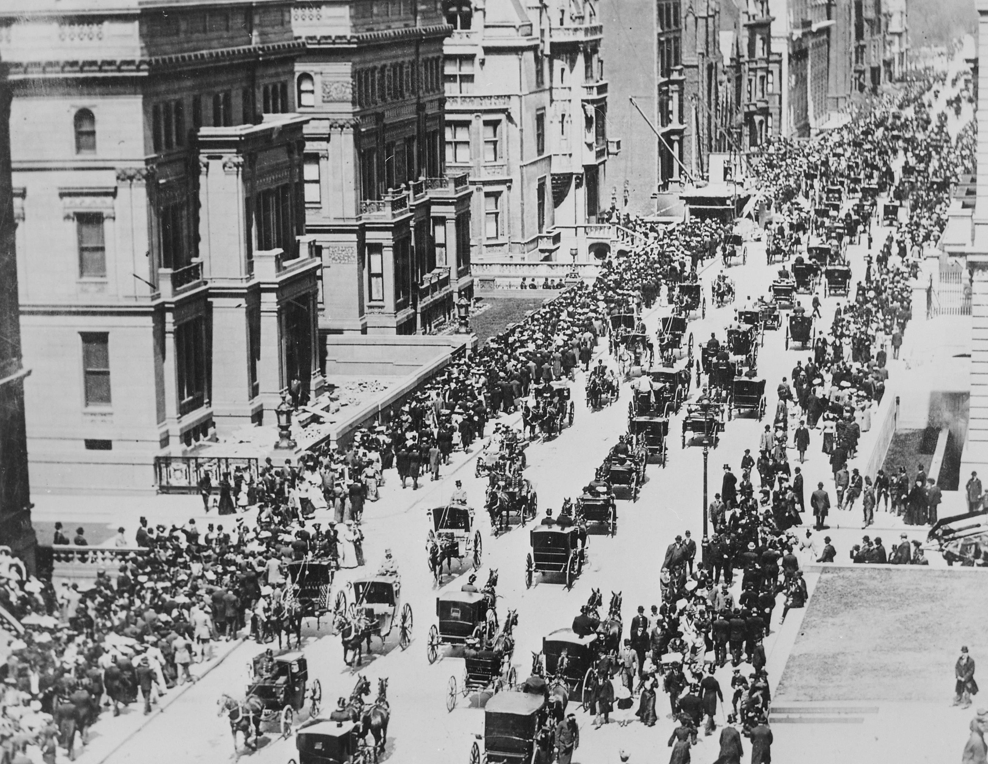





1900
5th AVE NYC
Where is
the
car?
Credit: Clean Disruption by Tony Seba March 17, 2016
US National Archives
: Fifth Ave NYC on Easter Morning 1900

Slide 15





1913
5th AVE NYC
Where is
the
horse?
Credit: Clean Disruption by Tony Seba March 17, 2016
George Grantham Bain Collection
Photo: Easter 1913, New York. Fifth Avenue looking north.

Slide 16

iPhone vs Technology 2007
The iPhone is only 14 years old, can you remember life prior to smartphones? What happened to all of those products/companies?

Slide 17
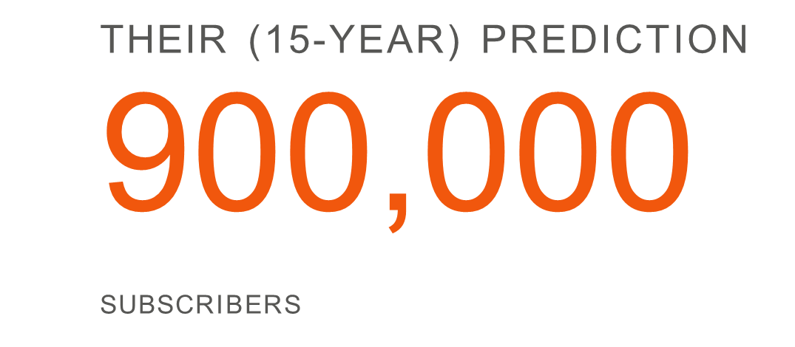
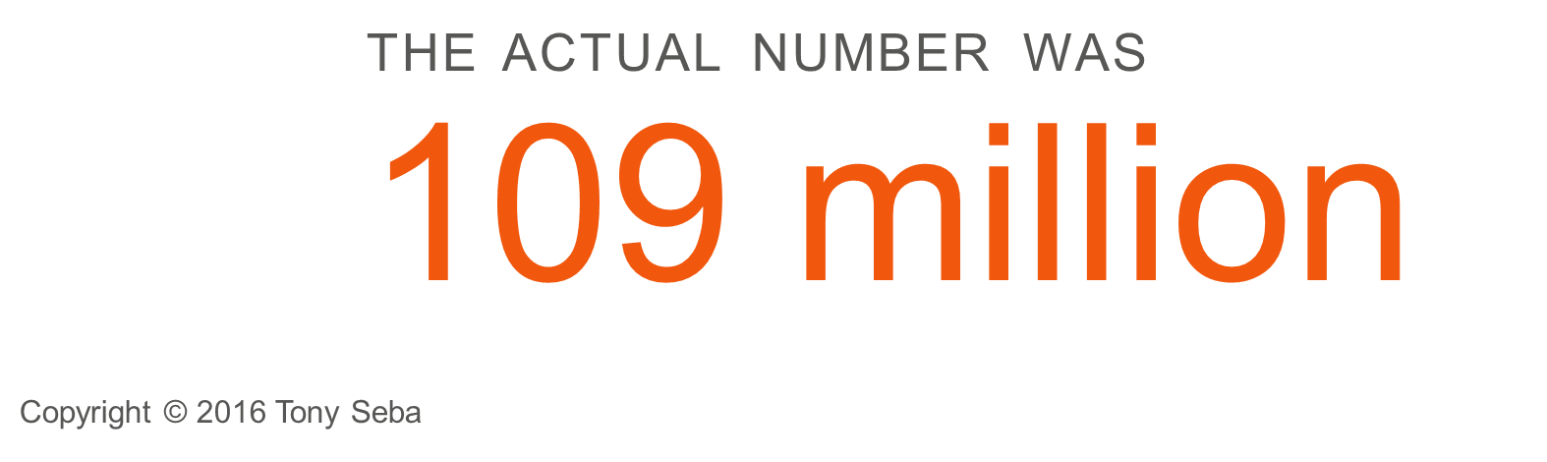
Why do we fail to anticipate disruptions and why do we not discuss how events may affect us and our business?
Why do smart people at smart organizations consistently fail to anticipate or lead market
disruptions?
It’s usually the ‘experts’ and ‘insiders’ who dismiss Disruptive Opportunities
Example:
‘Expert’ Disruption Forecasts
In the mid-1980s AT&T hired McKinsey & Co to forecast cell phone adoption by
the year 2000
They were off
by a factor of: 120X *
What about Kodak, Garmin, pagers, day planners and all of the products that don’t exist today and how it affected our business?
Credit: Clean Disruption by Tony Seba March 17, 2016

Slide 18
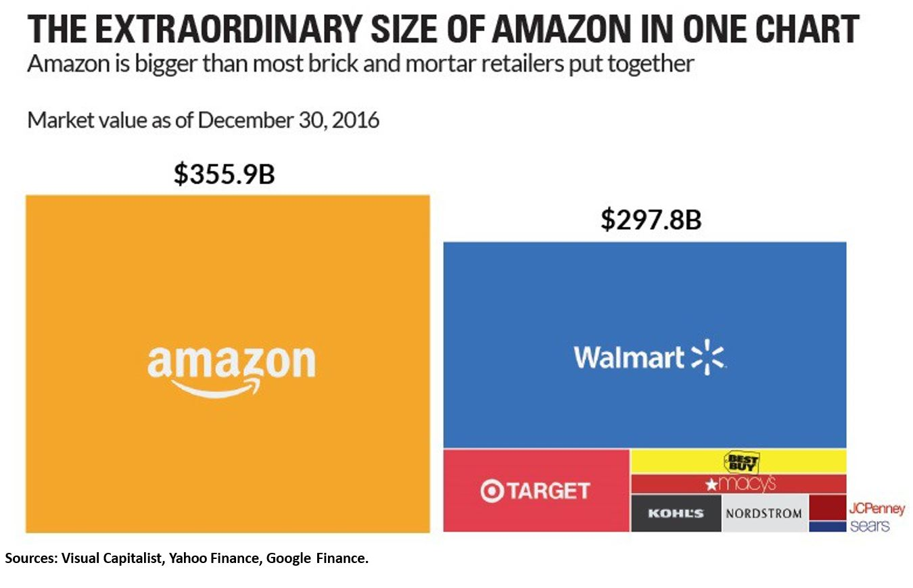
Notes:
18
18

Slide 19
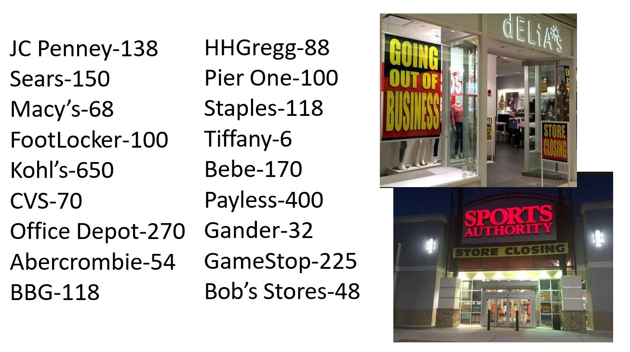
Retail Storefront Closings 2017
Notes:
19
19

Slide 20

Disruption in the Auto Industry is here
The technologies, skills, and organizations of the industrial revolution have run out of steam
They are being replaced by the technologies, skills, and organizations of the information technology revolution
Energy Storage
Electric Vehicles
Self-Driving Cars
Solar PV
Image: © Copyright Tony Seba
We will see more changes transportation over the next 5-10 years
than we have seen in a century, will it affect me and my business?
Credit: Clean Disruption by Tony Seba March 17, 2016

Slide 21
When is the next Disruption coming?
It is here, it’s happening now?
It is not clearly understood
It is hard to describe
It could be a big disruption, or it could be small
It might directly affect your company or indirectly but, it will affect ALL
No one knows exactly but, investment in disruptive technology is exponential with new players entering the race daily and markets changing at exponential rates
Have you discussed what plans you might have just in case?
What can a Company do to prepare for a disruptive event?

Slide 22
Who will it affect the most?
Companies that are committed/stuck in old technology or soon to be obsolete products
Companies who are not profitable or have the balance sheet to react or play in the new market
Companies who are not aware of changes around them both at customer and supply chain level
Companies that do not have any new or innovative technologies to distinguish themselves from their competitors
Companies with a “this is the way it has always been done” mentality or an “it’s not going to change and effect me” attitude
Any company that is not prepared for change and
can not react quickly will be affected

Slide 23
The Auto Industry has had record years prior to COVID and the stock market is still chugging along and unemployment is what it is…..
  Is it business as usual or should suppliers be concerned?
  Is there uncertainty once again in the supply chain?
  Is a disruptive event coming?
  Are you prepared for a disruption?
  What should you so to get prepared?
  What are the key elements that you can control?
  These are questions that I asked exactly 2 years ago in August
Notes:
23
23

Slide 24


COVID-19
  I felt like Fozzy Bear getting tomatoes thrown at me!!!
  Everyone thought things were going to slow down,
  but no one could have predicted this disruptive event was coming

Slide 25
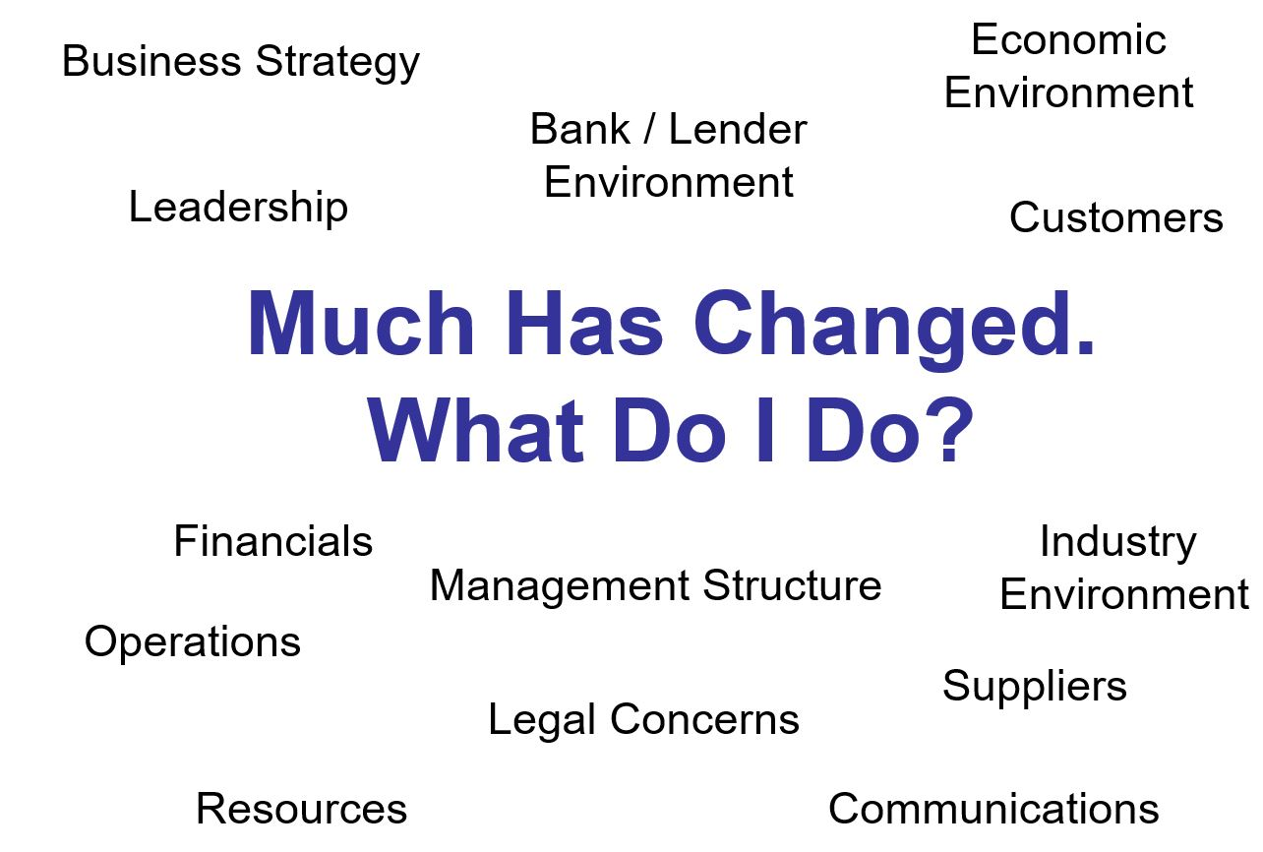
Notes:
25
25

Slide 26
As you know, the unprecedented coronavirus pandemic has had a dramatic ripple effect on privately held middle market companies with reduced customer demands, strained supply chains and general market disruption. Their company's future viability or sustainability may be in jeopardy. PPP monies have helped minimize some of these issues, but most of these company owners have invested most of their personal wealth in their business.
This has placed a heavy burden on their companies and their personal balance sheets. Thus, many privately held middle market companies find themselves facing a difficult situation of hoping for a speedy recovery and having to personally reinvest in the company or take on more debt. This is where we can help!
The Whitehall Group specializes in assisting privately held and family-owned companies. Whether your clients are looking to add to a business, sell the business, pass it on to a family member, or improve operations and profitability. We tailor a custom strategy to ensure they are prepared for transition and that the business will continue to grow and thrive, while maximizing their options and value.

Slide 27
TRANSITION PLANNING SERVICES
Organizational assessment, leadership development, executive coaching, and family business policies
Operational and profit improvement and turnaround and restructuring services.
Internal transitions, including family transfers, sales to key employees, mergers, and/or ESOPs.
External transaction research and execution, re-financing options, ie potential merger or sale.
SIX-STEP PROCESS FOR SUCCESS
Research & Evaluation: We take a comprehensive look at your client’s company and its current situation.
Financial Models: We create a series of financial models to compare various options and approaches.
Operational & Organizational Assessment: We evaluate the methods, processes, and talent to determine the direction of future operations to improve performance and increase profitability.
Alternatives: We explore alternatives to help your client meet business and personal objectives with a goal of maximizing their options, personal objectives, and financial goals.
Implementation & Execution: We work with your client, their team, and professional advisors to finalize and implement the transition strategy.
Maximize Value: We see the transition trough every phase to the conclusion and beyond.

Slide 28
Business Succession Considerations
4 Important Considerations
Have you thought about your succession: Clarifying objectives, setting goals, improving operations and increasing potential value
The magical 5X valuation multiple: Identifying current value, creating a plan and shoring up financial statement methods, procedures and maximizing profitability
Using competitive intelligence to drive your strategic thinking: Enhance or modify operations and appearance and maximize efficiencies – Become “Best in Class” maximizing value
Prepare now for your succession and/or sale: Complete objectives and check in consistently with your transition support team and control the process
This is a process, not just an event. It should be reviewed and adjusted regularly and at least annually (minimum).
Notes:
28
28

Slide 29
Have You Thought About Your Succession?
Consideration #1
Clarifying objectives, setting goals, improving operations and increasing value
Do you have a plan?
  Stay the course, grow aggressively, acquire another company and/or competitor
  Consistently thinking about your transition strategy
Are the operations running at its optimal level?
  Using the right set of metrics and key performance indicators (KPIs)
  Daily feel for performance and profitability
  Agility to manage the business – action vs reaction drives success
  Growth strategy can cause significant operational issues to existing business, if not managed effectively
  Cut losses quickly, if need be
Setting a Realistic Value for your business?
  Are you cash flow profitable? – If not why?- What can be done immediately?
  Establishing a range – Know how you stack up against the best in your field
  Understanding options – MBO, Merger, Outright Sale , Family Transition
Is this the right time for your succession? Is your business running at an optimal level? Can you control the process and maximize value?
Notes:
29
29

Slide 30
The Magical 5X Valuation Multiple
Consideration #2
Identifying current value, creating a plan and shoring up financial statement methods and procedures are critical, and understand where you are compared to the “Best in Class” in your marketplace.
EBITDA Multiples Primary Driver
  A means of establishing the economic value of an operating business
  No consideration for capital structure or taxes
  A negotiated final value based on numerous considerations
  In concept (5X cash flow less debt)
Business Performing at its Optimal Operational Level
  Maximizing profitability of operations
  Drives up EBITDA level
  Maximizes Valuation consideration
  For every $1 increase in EBITDA = $5 or more in sales price
Magical 5x Multiple
  Based on a return on invested capital (ROIC)
  Expected 20% return ( 1 divided by 20% = 5 )
  If ROIC exceeds the cost of capital, the business creates value
Setting realistic value expectations while understanding your industry, your competitors and the marketplace are critical.
Notes:
30
30

Slide 31
Using Competitive Intelligence to Drive your Strategic Thinking
Consideration #3
Enhance or modify operations and appearance and maximize efficiencies
Competitive advantages and market positions don’t disappear overnight
  Slowly lead a company astray one small misstep at a time
  Little assumptions that derail a company
Market Intelligence and Competitive Analysis
  Validate where your company stands competitively
  Facilitates both external and internal decisions
  Benchmarking against the best competitors creates “Best Practices”
Internal issues – good intelligence identifies areas requiring operational improvement to prioritize resource allocation accordingly and monitor progress
External opportunities – new market opportunities, acquisition options (including “not-for-sale” sellers), acquisition due diligence. Right intelligence provides confidence that nothing was missed
Knowing what is going on in the market will help you with your decision, timing and process while you maximize your current operating performance.
Notes:
31
31

Slide 32
Prepare Now for your Succession and/or Sale
Consideration #4
Complete objectives and check in consistently with your succession support team
Three dominant factors propelling M&A activity in the future
Growing tsunami of retiring Baby Boomer business owners
Information Age’s perpetual revolutions – and resulting market disruptions
Increasing global competitive landscape in which business must compete
Key Factors
Estimated 67% of today’s middle market business owners will reach retirement age by 2029
Waves of technological advances will drive the need for M&A going forward
Operational improvements to assist in the rapidly-accelerating trend toward a global economic world-order
Estimated $1 trillion in Private Equity Capital “dry powder” seeking business acquisitions
Talk to you Advisers
Operational Experts can improve on: 1) Appearance, 2) Efficiency, and 3) Maximize Profits
M&A experts can negotiate the nuances of a deal far beyond the price of the deal
Maximize the overall value of the sale by a realistic value analysis of your business performance
If selling is an option, understand the process and the market. Use your external transition team to evaluate objectively, just as a buyer would.
Notes:
32
32

Slide 33
Your Succession Planning Team
Whitehall works:
  With specialists in all areas effected by the transition plan for your organization.
  In establishing consistent and structured communication.
  In assisting with the understanding and implementation of your plan options throughout the process.
Some of the important parties to include in your planning are:
  Company Management
  Accounting Firm
  Legal Team
  Financial Institution
  Other Interested Parties (family/shareholders)
Succession Planning is a team sport. It’s a journey, not an event.
Notes:
33
33

Slide 34
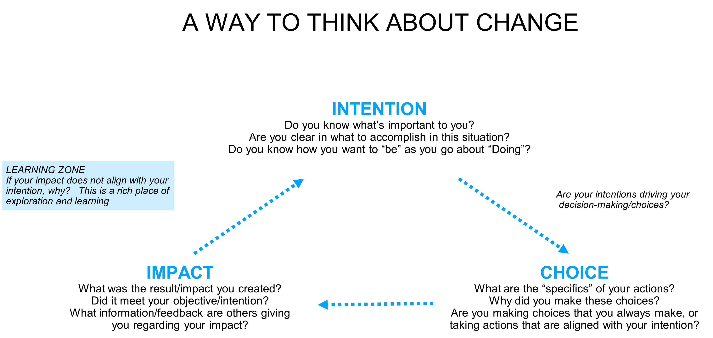

Slide 36
Leadership Circle Assessment
Notes:
36
36

Slide 37
A Coach helps to optimize the effectiveness of others by:
Tapping into their innate abilities
Optimizing their strengths
Navigating around their weaknesses
Stretching into new areas of growth and possibility
Executive Coaching
Notes:
37
37

Slide 38
The Qualities of a Good Coach
Listens, Listens & Listens
Has a “Beginner’s Mind”
Strategic
Is Generous of Spirit
Gets “out of the way”
Considers creative possibilities
Is unattached to their POV
Looks to maximize situations
Situations are opportunities to learn
Uses intuition, smarts and wisdom
Ask’s Powerful Questions
Notes:
38
38

Slide 39
Four Premises from Mastering Leadership
Structure determines performance
You are a structure – have an inner and outer “game”
Consciousness is the operating system of performance
To achieve higher performance, you must be restructured; consciousness must evolve to a high level of complexity to meet the complexity of today's business challenges
Notes:
39
39

Slide 40
What happens when you don’t plan…..
Case Study #1
A $600 million dollar company with 26 plants around the world whose founder invented the sunroof
Untimely death of Owner with no transition plan in place sent company spiraling downward and financial and organizational chaos
After 7 years of internal arguing between management and family owners the company was reduced to a $20 million dollar company consistently losing money
Continual losses occurred leading to Bankruptcy
Eventually purchased by private equity firm when it was reduced to a $8 million dollar business and losing $4 million per year and losses continued for years
Whitehall was hired to evaluate the business and/or close it down to stop the losses
The company was restructured, rebuilding the business and returning it to profitability – ultimately was sold again to offset years of losses
This sad but true situation was totally due to zero succession/family planning. “This will never happen to us!!!”
Notes:
40
40

Slide 41
A Successful Family Succession Plan…
Case Study #2
A 100-year-old family-owned specialty candy manufacturing company looking to transition to the next generation with multiple family lines and individuals
Parties included several different levels of skillsets, interests, education, age and family structure i.e. brothers, cousins, etc.
No clear track for future management in place
Whitehall assessed the current organization, individual skillsets, capabilities and interests to provide a clear plan for transition including roles, responsibilities, and family positions/overall structure
Implementation was achieved through training, organizational restructuring, redefined job descriptions, new metrics and internal accountability
A 1-year transition/monitoring plan was put in place to shift from existing management structure to a new management team and corporate governance including current ownership and existing advisors
The end result was a smooth transition and a stable business that continues to grow with clear transition plan, accountability, monitoring, and feedback
A successful family transition requires a lot of planning, training communication and governance if you are going to beat the odds.
Notes:
41
41

Slide 42
A Successful Sale
Case Study #3
$30 million dollar business that steadily made money and could have continued at that level indefinitely
Owner wanted transition out of the business but, did not want this to be public knowledge and wanted minimal disruption with the employees, customers and stakeholders
Whitehall used its relationships to get the company partially purchased and the debt and balance sheet transferred to the new owners
Upon purchase of the business the new owners engaged sought to increase capital by in order to update equipment, expanding capacity and to go from an order taking enterprise to a growth-oriented business
The entire process was quietly done with no job losses, minimal disruption and owner transitioned from a 100% owner to a minority status and board member
After 4 years the company had doubled in sales and more then doubled in profits while being positioned for future growth
All interested parties, original owner, new owner, employees, customers, and bank are happy with the outcome
The original owner’s value at final exit as a minority stakeholder was worth more than previously as the 100% owner
With a succession plan and proper execution, options are available, values are maximized and all parties walk away winners
Notes:
42
42

Slide 43
When do I need to start planning? – NOW!
No business can remain static
Restructure and Enhance Operations
Achieve Best In Class Operations
High Growth Organization
Management or Employee Ownership Transfer
Family Ownership Transfer
Third Party Sale
Leverage Operations
Specific Projects/Goals
Strategic Planning
Succession Planning
Health and Family issues
These are important decisions that need careful attention and planning prior to being “forced” into a transition.
Notes:
43
43

Slide 44
Building Value “Where’s The Money” - Challenges
Critical Go Forward Items to building value in Transition Planning
Keep financials in order – manage cash
Manage the business with data
Know if you’ve met financial / operational objectives
Understand your customers and their contribution
Manage and challenge the entire supply chain
Manage the business in a War Room environment
Change culture, accountability and agility (Be ready to act not forced to)
  For business transition to be successful, the highest priorities have to be having a plan, maximizing performance and being prepared
Notes:
44
44

Slide 45
What are the Benefits?
Efficient and effective operations will drive value
Optimize profits
Minimize tax aspects
Provide control of timing and method of transition
Develop leadership and management individuals & teams to execute your transition
Provide financial security to all of the affected parties
Provide business continuity and key position retention throughout the transition
Promotes family harmony and understanding of goals/objectives/timing.
With proper planning, you will maximize your options, which will maximize your value in any transition scenario.
Notes:
45
45

Slide 46
It’s an ever-changing business climate and our team of professionals at the Whitehall Group can assist you and your clients with Business Transition Guidance to ultimately minimize risk, strengthen their banking position and improve profitability and shareholder value.
Joseph Bione and James Linton
100 W. Big Beaver, Suite 650
Troy, MI 48084
Office: 248 - 519-1072/1075
Cell: 248 - 227-3436
bione@whitehallgroupllc.com or jamesl@whitehallgroupllc.com
Visit our website: www.whitehallgroupllc.com
For more information or a consultation:
Notes:
46
46

